Slide 1
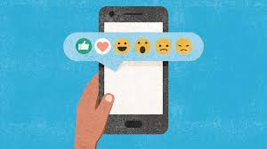
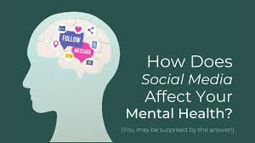
Social Media Usage and Emotional Well-Being
Data Sources: Social Media Usage and Emotional Well-Being (kaggle.com), github.com/topics/social-media-usage
Bratati Chakraborti

Slide 2
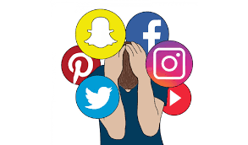
Title and Content Layout with List

Slide 3
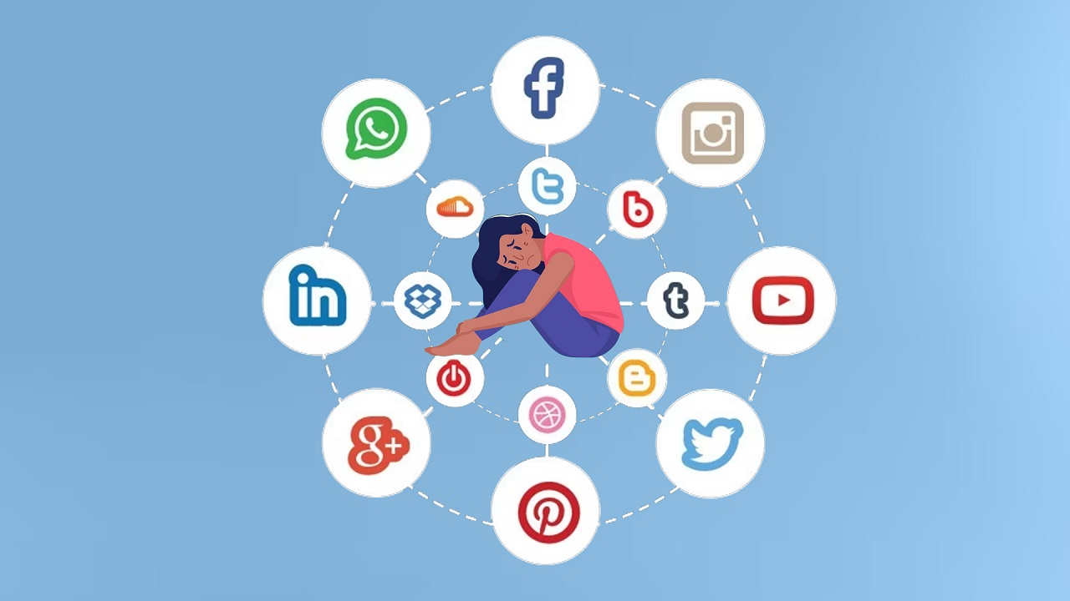
Title and Content Layout with Chart

Slide 4

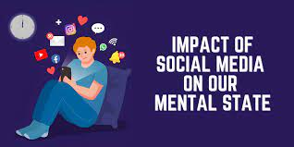
Databrick

Slide 5
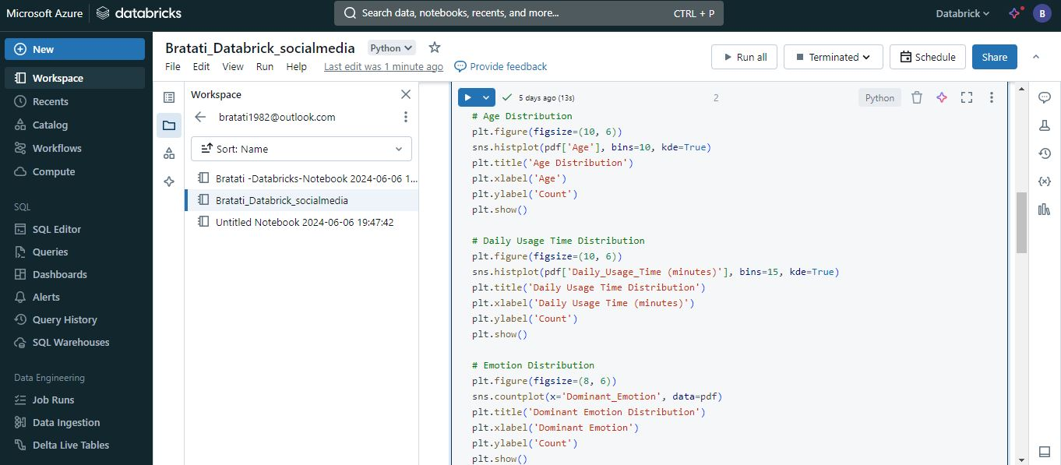

Slide 6
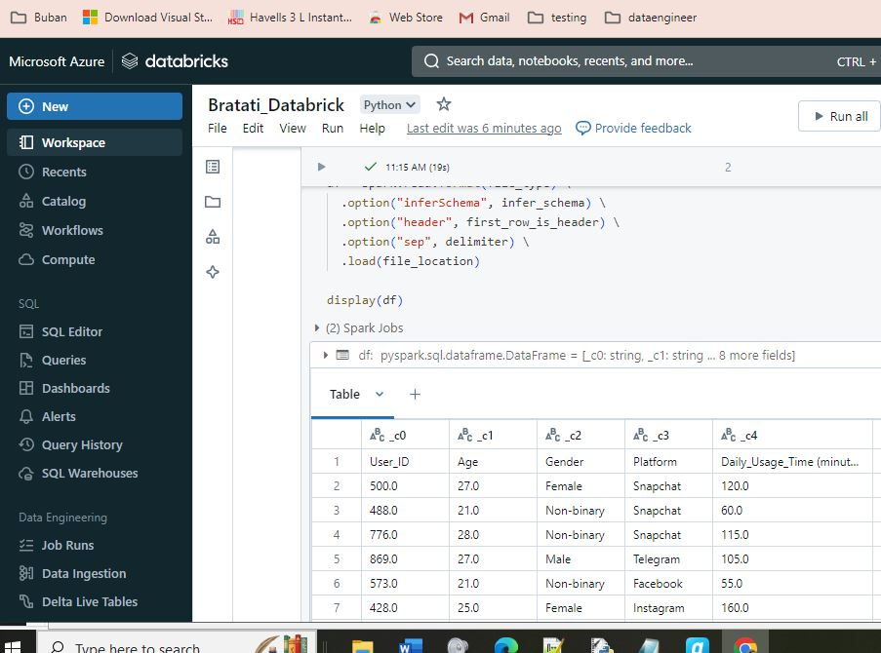

Slide 7


Slide 8
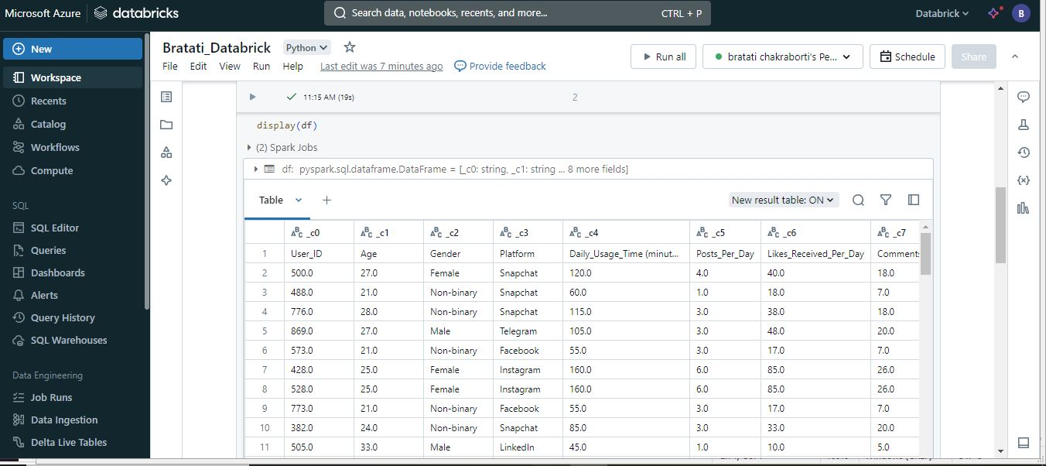

Slide 9
